Slide 1
Digestion
Day 2
Stomach-Liver

Slide 2
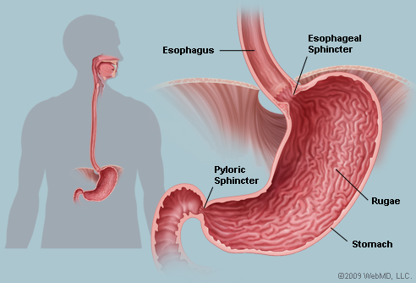
Stomach
J-shaped organ
Found in upper left portion of abdom. cavity
Can hold 1 Liter or more
Contains thick folds in lining called RUGAE
Functions:
Receives food from esophagus
Mixes food with gastric juices
Initiates protein digestion
Carries on limited absorption
Moves food into small intestines

Slide 3
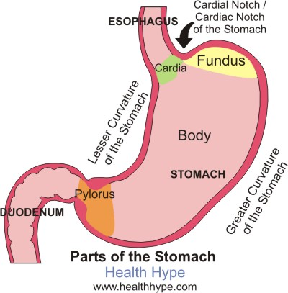
Parts of the Stomach
Four Parts
Cardia
Small area near esophageal opening
Fundus
Balloons superior to cardia and is a temporary storage area
Body
Main part of stomach, found between fundus and pylorus
Pylorus
Near small intestine, narrows to form pyloric canal
Pyloric Sphincter
Valve that controls gastric emptying

Slide 4
Gastric Secretions
Mucous membrane forms inner lining
Contains gastric pits which lead to gastric glands
Gastric Glands produce three types of secretions known as GASTRIC JUICE
Mucous cells
Found near opening of glands, produce mucus
Chief Cells
Found deeper in glands, produce digestive enzymes
Parietal Cells
Found deep in glands, produce HCL (Hydrochloric Acid)

Slide 5
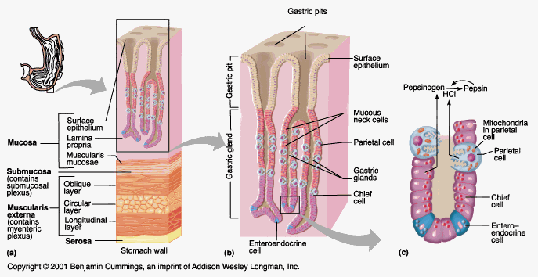
Gastric Juices
Pepsin
Most important digestive enzyme
Produced by chief cells
Forms when PEPSINOGEN contacts HCL
Breaks down protein
Mucous Cells
*Forms a alkaline secretion that covers inner surface of stomach wall
*Prevents stomach from digesting itself

Slide 6
Gastric Juices Cont.
Intrinsic Factor
Secreted by parietal cells
Helps small intestine absorb vit. B12
Regulation of Gastric Secretion
Produced continuously, but rate varies
Controlled neurally and hormonally
Thinking of food or food entering stomach causes stimulation of ACH and gastrin which increase secretory activity
Once food enters small intestine, hormone cholecystokinin stimulates decrease in gastric juice production

Slide 7
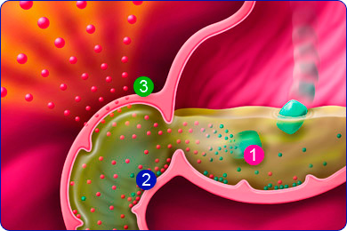
Gastric Absorption
Enzymes break down proteins but does not absorb much
What’s absorbed:
Only small amounts of water and certain salts are absorbed
Lipid-soluble drugs
Alcohol

Slide 8
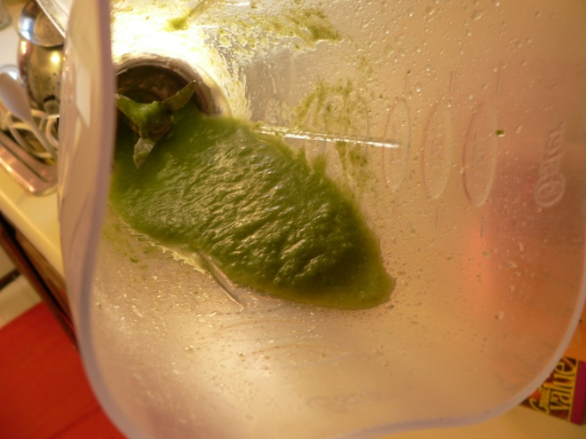
Mixing and Emptying Actions
Chyme
Produced after a meal
Consists of gastric juices and food particles
Semi fluid paste
Peristaltic waves push Chyme towards pyloric sphincter
Little by little Chyme is pushed into small intestines
Rate depends on type of food and fluidity of chyme
Liquids pass through stomach rapidly
Fatty foods remain for 3-6 hours after consumption
High protein foods are quicker than fats
Carbs are faster than proteins

Slide 9
Vomiting
Results from a complex reflex that empties the stomach in the reverse of the normal direction. Irritation or distension in the stomach or intestines can trigger vomiting. Sensory impulses travel from the site of stimulation to the vomiting center of the Medulla, and motor responses follow. These include taking a deep breath, raising the soft palate and thus closing the nasal cavity, closing the opening to the trachea, relaxing the circular muscle fibers at the base of the esophagus, contracting the diaphragm so it presses downward over the stomach, and contracting the abdominal wall muscles to increase pressure inside the abdominal cavity. As a result, the stomach is squeezed from all sides, forcing its contents upward and out through the esophagus, pharynx, and mouth.

Slide 10
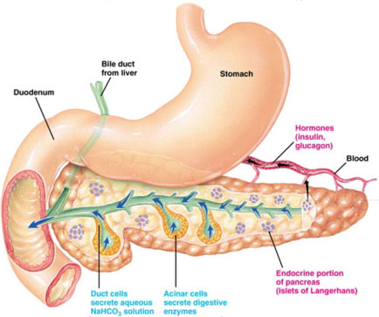
Accessory Organs
Once food leaves the stomach and enters the small intestine accessory organs add digestive juices
Pancreas
Lies horizontal across the posterior abdominal wall
Cells called pancreatic acinar produce pancreatic juice
Secretions in to small intestine are controlled by hepatopancreatic sphincter

Slide 11
Pancreatic Juice
Contains enzymes that digest carbs, fats, nucleic acids, and proteins
Pancreatic amylase
Splits carbs
Pancreatic lipase
Splits fat molecules
Nucleases
Break down nucleic acid molecules
Trypsin, Chymotrypsin, Carboxypeptidase
Split proteins

Slide 12
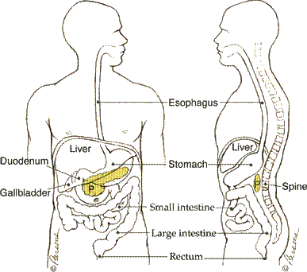
Regulation of Pancreatic Secretions
Nervous and Endocrine systems regulate release of pancreatic juices
Hormone Secretin
Released when chyme enters small intestine to neutralize it

Slide 13
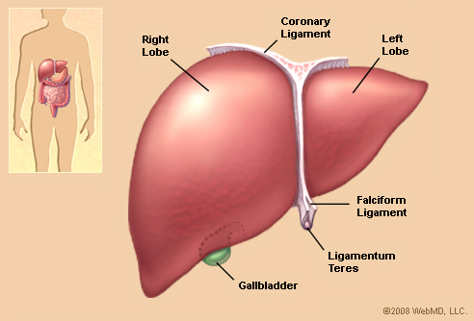
Liver
Found in upper right quadrant of abdominal cavity just inferior to diaphragm
Packed with blood vessels
Structure
Large right lobe, smaller left lobe
Hepatic lobules are the functional units
Hepatic sinusoids
Vascular channels that receive newly absorbed nutrients
Contains phagocytic cells called Kupffer Cells
Help remove bacteria and other foreign particles
Contains many hepatic ducts that merge to form common hepatic duct

Slide 14
Liver Function
Important metabolic activites
Carb metabolism
Maintains blood glucose
Lipid metabolism
Fatty acid metabolism
Most important is protein metabolism
Stores glycogen, iron, vitamins A, D, and B12
Destroys damaged RBC’s
Removes toxic substances such as alcohol and drugs
Secretes Bile (Important to Digestion)

Slide 15
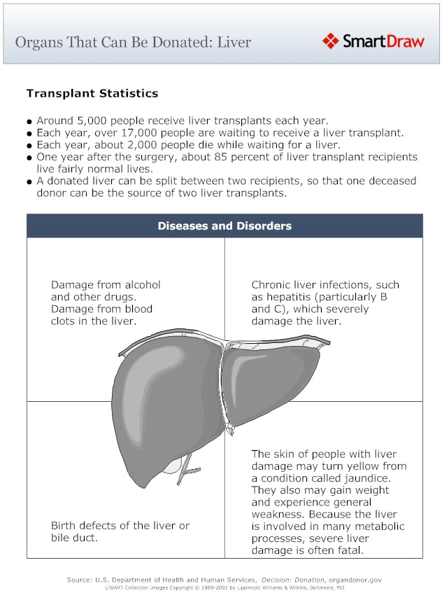
Liver Donations
The liver is unlike most organs in that it can regenerate. Up to 75% of a liver can be destroyed and the organ can regenerate and recover. For this reason, people can donate parts of their livers to people in liver failure, if the tissues of the donor and recipient are compatible.

